Slide 1


DR. AKHILESH DAS GUPTA INSTITUTE OF TECHNOLOGY & MANAGEMENT
PREDICTION OF TAXI FARE USING MACHINE LEARNING
NISSAN SUNWAR(06515602821)
SHIVANSH TIWARI(05815602821)
AYUSH KUMAR(04096203121)
MS Naina Devi
(Project Supervisor)

Slide 2
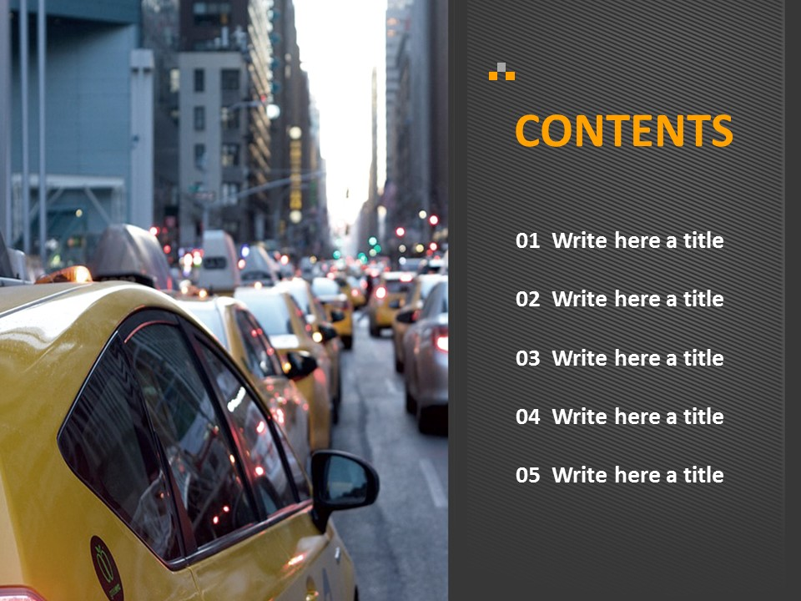
Introduction
Project Overview: Taxi Fare Prediction using Machine Learning. An Exploration of Methods and Algorithms
Objective: Introduce the widespread use of machine learning of predictions
Significance: Showcase its impact across various applications globally.
Approach: Provide an overview of supervised and unsupervised learning.

Slide 3


The problem we address in taxi fare prediction:
Inaccurate Estimates: Traditional models lack precision due to dynamic factors like traffic and events, leading to unpredictable costs.
Customer Discontent: Inaccurate fare predictions result in dissatisfaction among passengers, impacting user experience and loyalty.
Operational Inefficiency: Taxi companies face challenges in resource allocation, as demand patterns aren't effectively anticipated.
Transparent Pricing: Existing models struggle to provide transparent pricing, leading to distrust and confusion among passengers.
Our goal is to leverage predictive modeling to overcome these challenges, providing accurate fare estimates that enhance user satisfaction, operational efficiency, and transparency in taxi fare prediction.

Slide 4

METHODS USED
1
3
MACHINE LEARNING
LINEAR REGRESSION
2
EDA

Slide 5


Importance of Predictive Modeling in Taxi Fare Prediction
Accuracy:Accurate fare estimates satisfy passengers and aid companies in transparent pricing.
Efficiency:Predicting demand optimizes resource allocation, reducing wait times.
Dynamic Pricing: Real-time adjustments based on traffic and events balance supply and demand.
Customer Satisfaction: Informed decisions lead to positive user experiences and loyalty.
Revenue Strategy:Strategic fare adjustments maximize profits while remaining competitive.
Revenue sights:Travel patterns and routes drive data-driven decisions for growth.
Risk Management:Predictive models mitigate financial uncertainties for both passengers and companies.
Competitive Edge: Reliable fare predictions attract customers and establish trust.
In essence, predictive modeling transforms the taxi industry,
aligning it with evolving demands, enhancing transparency,
and elevating the transportation experience.

Slide 6
Machine Learning used for Taxi Fare Prediction
1. Data Collection:
Collect a dataset containing information about taxi rides, including features like distance traveled, pickup and drop-off locations, time of day, and the actual fare paid.
2. Exploratory Data Analysis (EDA):**
Explore the dataset to understand its characteristics and relationships:
- Analyze data distributions, checking for outliers and anomalies.
- Visualize the relationship between fare amounts and features like distance and time of day.
- Investigate correlations between variables, like how fare amount correlates with distance.
3. Data Preprocessing:
Clean and prepare the dataset for modeling:
- Handle missing values, potentially using imputation methods.
- Convert categorical variables like pickup/drop-off locations into numerical values using techniques like one-hot encoding.
- Normalize numerical features to ensure they're on a similar scale.
4. Feature Engineering:
Create new features to enhance the predictive power of the model:
- Extract features from timestamps, like day of the week or time of day.
- Calculate additional metrics, such as average speed or distance to popular locations.

Slide 7
**5. Data Splitting:**
Divide the dataset into training and testing sets to evaluate model performance:
- Allocate a portion of the data for training and the remainder for testing.
**6. Model Selection:**
Choose suitable machine learning algorithms for regression:
- Linear Regression: As a baseline model for simplicity.
- Gradient Boosting Regressor: To capture complex relationships and interactions.
**7. Model Training:**
Train the selected models using the training data:
- Provide features (distance, time-related features, etc.) and the corresponding target variable (fare amount).
- The algorithms adjust their parameters to learn from the training data.
**8. Model Evaluation:**
Evaluate model performance using appropriate metrics:
- Root Mean Squared Error (RMSE) or Mean Absolute Error (MAE) for regression problems.
- Compare the performance of both models on the test data.
**9. Hyperparameter Tuning:**
Optimize model hyperparameters to improve performance:
- Utilize techniques like grid search or random search to find the best hyperparameter values.
.

Slide 8
Exploratory Data Analysis (EDA):
Exploratory Data Analysis is a crucial preliminary step in data analysis that involves visually and quantitatively summarizing, interpreting, and understanding the main characteristics of a dataset.
1. **Data Overview:** EDA begins by gaining a high-level understanding of the dataset's structure, including the number of observations (rows), variables (columns), and data types.
2. **Univariate Analysis:** This involves analyzing individual variables in isolation to understand their distributions, central tendencies (mean, median), spread (variance, standard deviation), and potential outliers.
3. **Bivariate Analysis:** Exploring relationships between pairs of variables helps uncover correlations, associations, and dependencies. Scatter plots, correlation matrices, and cross-tabulations are commonly used.
4. **Multivariate Analysis:** This involves considering interactions between three or more variables. Techniques like heatmaps, 3D plots, and dimensionality reduction methods (PCA, t-SNE) can help visualize complex relationships.

Slide 9
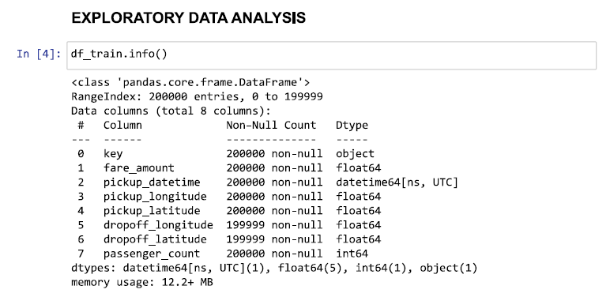
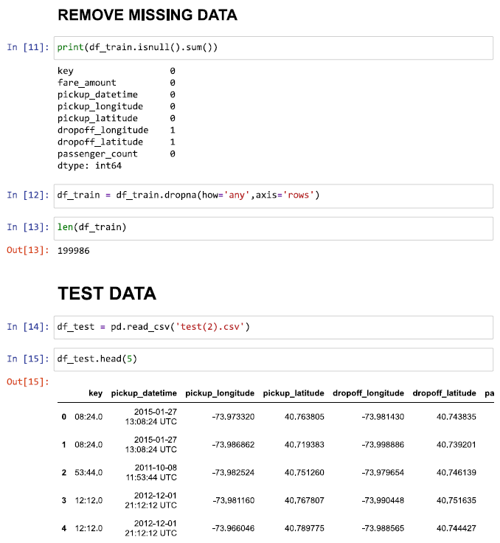
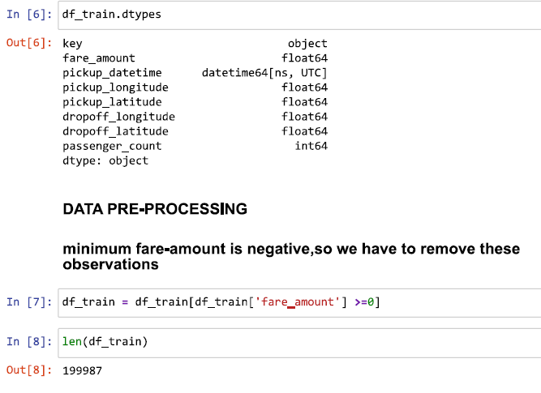

Slide 10
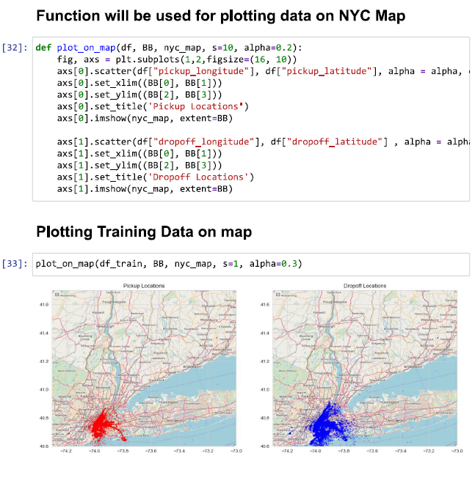
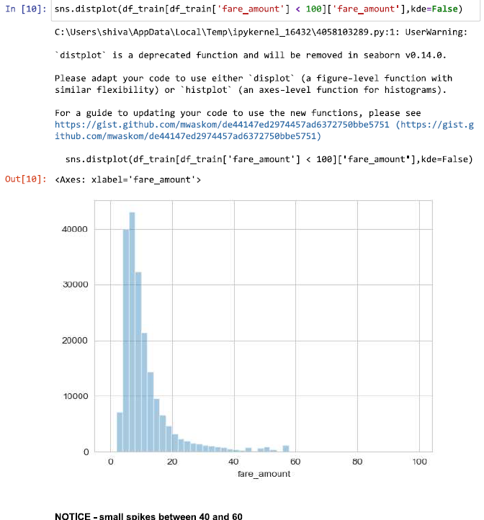
CODE & IMPORTANT GRAPHS

Slide 11
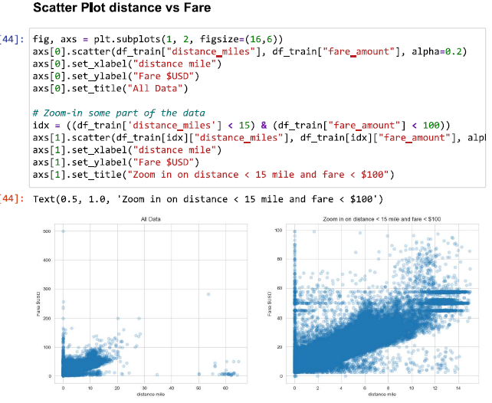
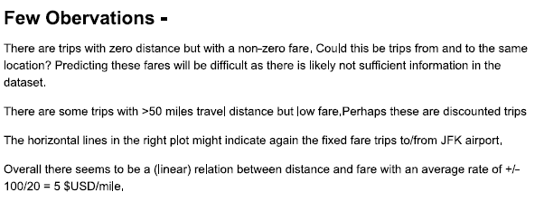

Slide 12
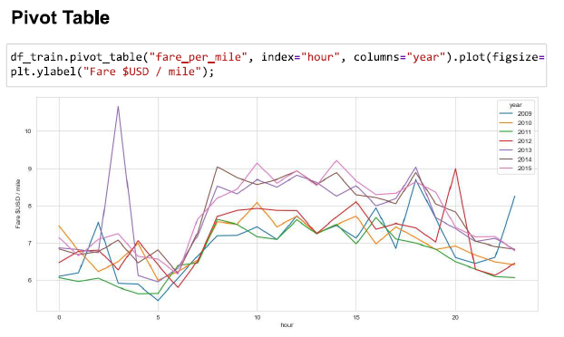

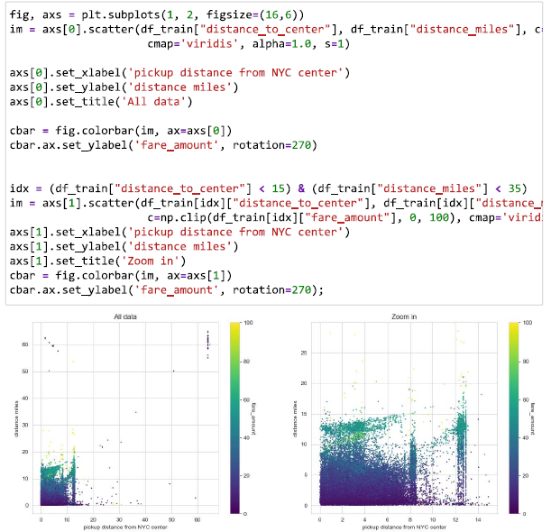

Slide 13
Linear Regression:
Linear Regression is a fundamental machine learning algorithm used for understanding and predicting the relationship between two or more variables. It's particularly suited for scenarios where you have a dependent variable (what you're trying to predict) and one or more independent variables (used for prediction).
Application:**
Linear Regression finds applications in various fields:
- Economics: Predicting sales based on advertising spending.
- Finance: Estimating stock prices using historical data.
- Medicine: Predicting patient outcomes based on medical data.
- Social Sciences: Analyzing factors influencing educational
achievement.
In summary, Linear Regression is a foundational algorithm that helps us understand and quantify relationships between variables by fitting a straight line through data points. It's a stepping stone for more advanced regression techniques and provides a clear way to make predictions based on data.

Slide 14
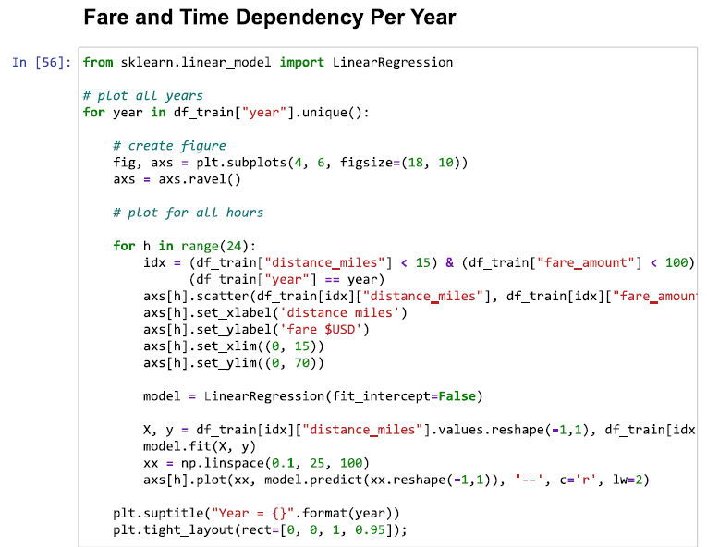
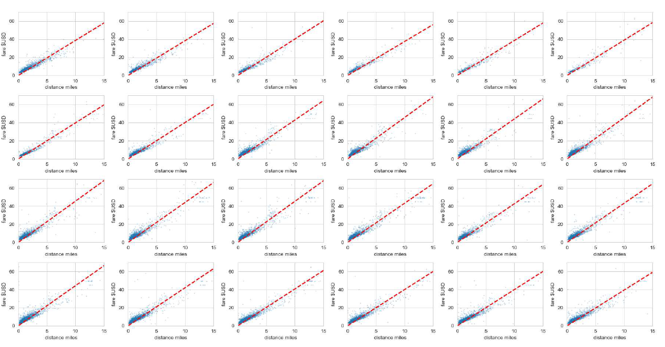
CODE & Output (graph)

Slide 15
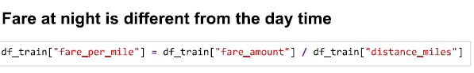
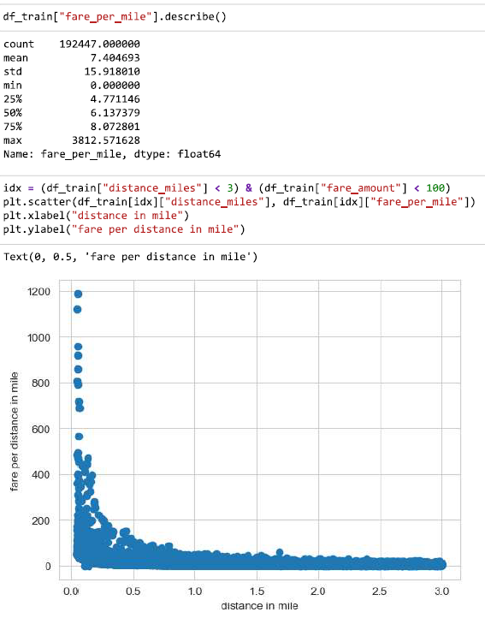
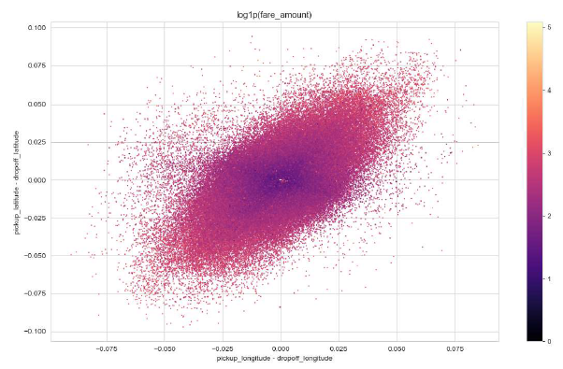
EFFECT OF LONGITUDE & LATITUDE

Slide 16
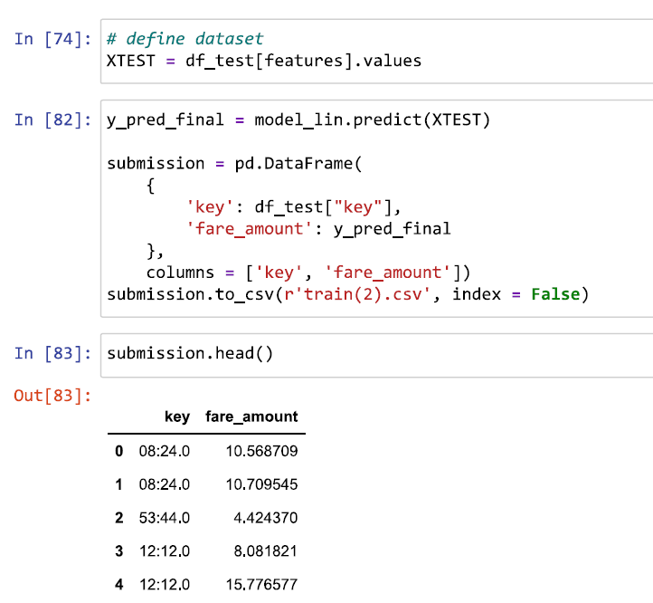
RESULT AND DISCUSSION
So, now we have developed few models for predicting the target variable, now the next step is to identify which one to choose for deployment. To decide these according to industry standards, we follow several criteria. Few among this are, calculating the error rate, and the accuracy. MAE and MAPE is used in our project. MAE or Mean Absolute Error, it is one of the error measures that is used to calculate the predictive performance of the model. In this project we will apply this measure to our models
The second matrix to identify or compare for better model is Accuracy. It is the ratio of number of correct predictions to the total number of predictions made. Accuracy= number of correct predictions / Total predictions made.
Method | Accuracy (in Percentage)
Random Forest | 79.7864
Linear Regression | 71.8255
Method | Mae Error( in Percentage)
Random Forest | 20.2135
Linear Regression | 28.1744

Slide 17

CONCLUSION
Taxi fare prediction is vital in the automobile industry.
Employed linear regression for accurate fare estimation.
Achieved 71.82% accuracy through the linear regression model.
MODEL INSIGHTS:
Linear regression provides interpretable insights into fare determinants.
Its accuracy and transparency enhance its suitability for the domain.

Slide 18
FUTURE WORK
Enhanced Feature Engineering:
Explore advanced feature selection techniques specific to taxi fare prediction.
Consider integrating external data sources for enriched modeling.
Time-Series Analysis:
Incorporate time-related factors like day of the week, holidays, and rush hours.
Time-series modeling can capture temporal patterns for better predictions.
User Behavior Incorporation:
Include passenger behavior data to enhance fare estimations.
This could involve factors like booking history and preferred routes.
Integration of Dynamic Factors:
Real-time weather and traffic data can improve accuracy.
Developing a model that adapts to changing conditions can lead to more precise predictions.
These future directions focus on refining the predictive accuracy of taxi fare models by delving deeper into the domain-specific intricacies and leveraging additional data sources.

Slide 19



